Slide 1

ECE 281
Lesson 2
Maj Jeffrey Falkinburg Room 2E46E 333-9193
1

Slide 2
Lesson 2 Outline
Addition/Subtraction
Carry/Overflow
Negative Numbers
Logic Gates
Noise Margin
Skills Review Due Next LSN
Fill in the blank Exercise

Slide 3
Bitbucket
Create Private Bitbucket Repository
https://bitbucket.org/
Name repo something like “ECE281_YourName”
Give me access to repo. My Username: jfalkinburg
Example/Template Lab Notebook:
http://ece.ninja/383/lab/labnotebook.html
https://github.com/jfalkinburg/ECE_382_Lab_Ex/

Slide 4
Exercise
Decimal | Binary | Hexadecimal
2007
 | 11011
 |  | DFEC

Slide 5
Number Conversions
Hex Digit | Decimal Equivalent | Binary Equivalent | Octal Equivalent
0 | 0 | 0000 | 0
1 | 1 | 0001 | 1
2 | 2 | 0010 | 2
3 | 3 | 0011 | 3
4 | 4 | 0100 | 4
5 | 5 | 0101 | 5
6 | 6 | 0110 | 6
7 | 7 | 0111 | 7
8 | 8 | 1000 | 10
9 | 9 | 1001 | 11
A | 10 | 1010 | 12
B | 11 | 1011 | 13
C | 12 | 1100 | 14
D | 13 | 1101 | 15
E | 14 | 1110 | 16
F | 15 | 1111 | 17
Copyright © 2007 Elsevier

Slide 6
Addition

Slide 7
Subtraction

Slide 8
Carry/Overflow
Overflow – Overflow occurs when the answer is too big to fit in the available number of bit
The answer is not the correct sign (2’s Comp)
Carry – Whenever your answer takes more than a single bit, the extra bit is a carry.
What about Negative numbers?

Slide 9
Negative Numbers – Signed Magnitude

Slide 10
Negative Numbers – 2’s Complement

Slide 11
Negative Numbers – Unsigned Binary

Slide 12
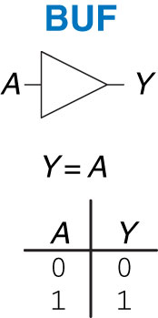
Buffer
Figure 1.13 Buffer

Slide 13
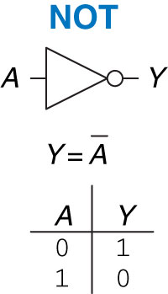
NOT Gate
Figure 1.12 NOT gate

Slide 14
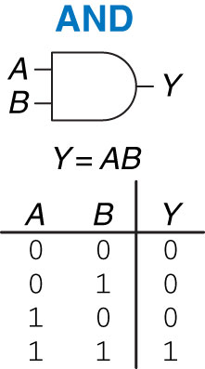
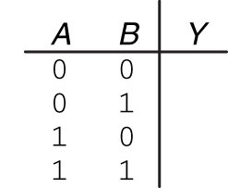
AND Gate
Figure 1.14 AND gate

Slide 15
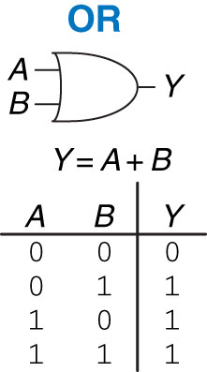
OR Gate
Figure 1.15 OR gate

Slide 16
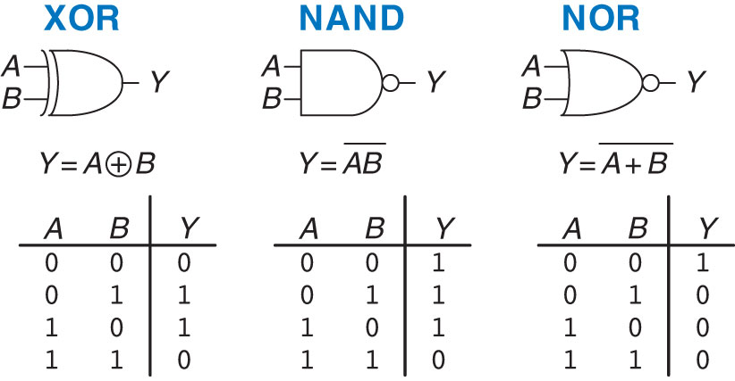
XOR, NAND, and NOR Gates
Figure 1.16 More two-input logic gates

Slide 17
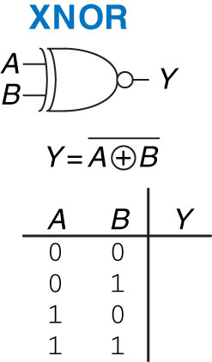
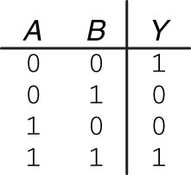
XNOR Gate
Figure 1.17 XNOR gate
Figure 1.18 XNOR truth table

Slide 18
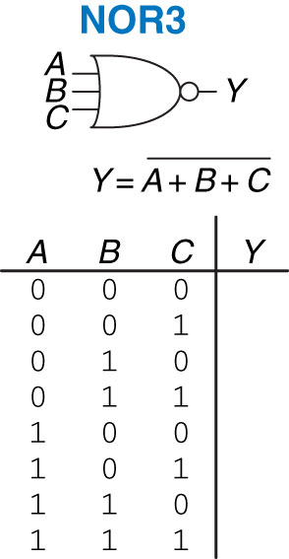
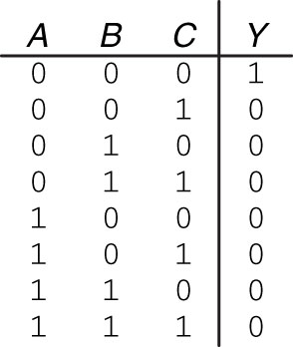
Three-input NOR Gate
Figure 1.19 Three-input NOR gate
Figure 1.20 Three-input NOR truth table

Slide 19
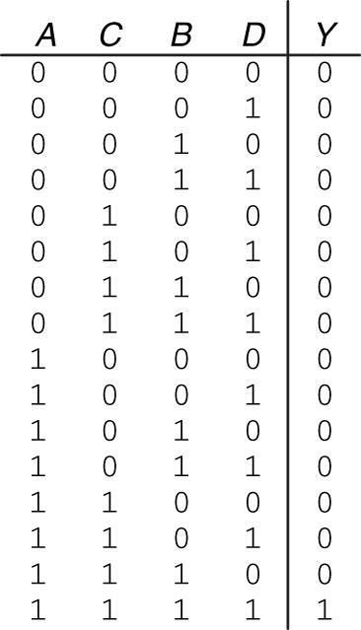
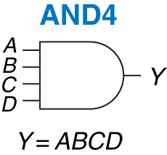
Four-input AND Gate
Figure 1.21 Four-input AND gate
Figure 1.22 Four-input AND truth table

Slide 20
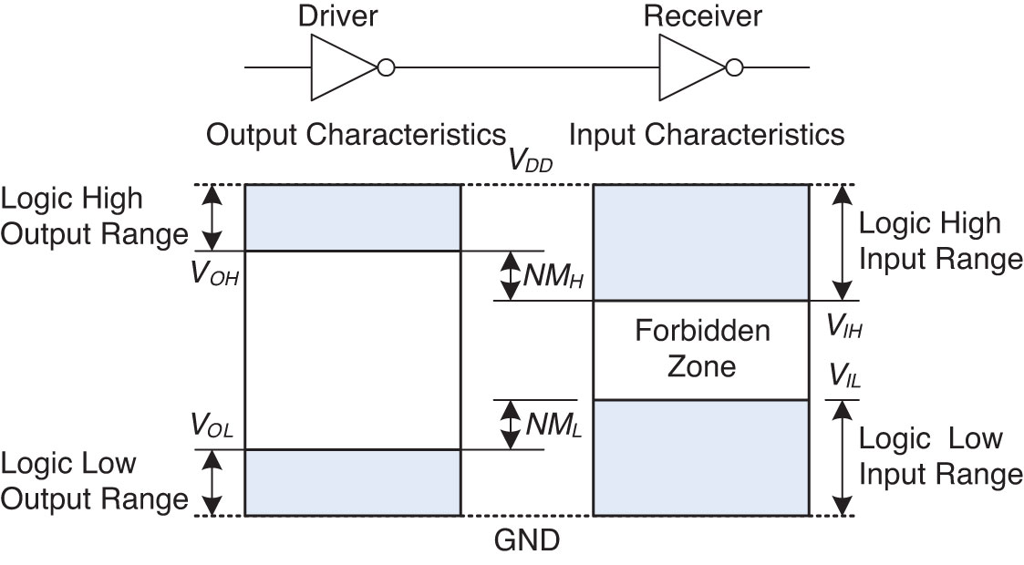
Voltage Levels and Noise Margins
Figure 1.23 Logic levels and noise margins

Slide 21
Extra Instruction (EI)
Capt Jeffrey Falkinburg
2E46E
Office: 333-7366
M1
ECE 281 – 2F44
T1
M2
ECE 281 – 2F44
T2
M3
ECE 463 – 2G2
T3
ECE 383 – 2E48A
M4
ECE 463 – 2G2
T4
ECE 383 – 2E48A
Available
M5
T5
Sometimes Available
M6
ECE 383 – 2E48A
T6
Always Unavailable
M7
ECE 383 – 2E48A
T7

Slide 22
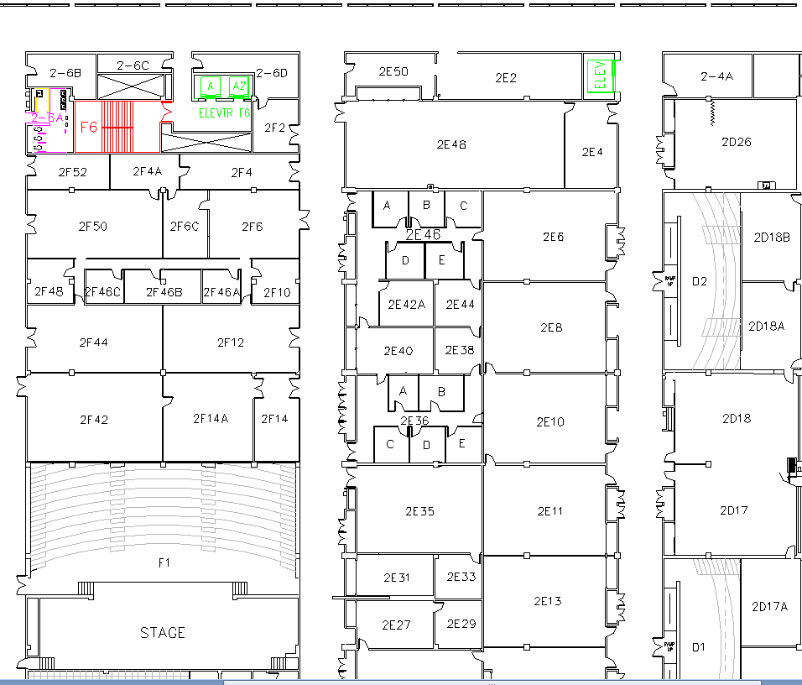
West (Terrazzo) Side

